Slide 1
Energy Broker Alternative Dispute Resolution (ADR) Scheme Complaint Journey
26th May 2022

Slide 2
Agenda
Introduction
Complaint Journey Overview
Case Management System
Benefits
Case File
Importance of details
Information to include
Investigation Process
Resolutions
General principles
Fixing problems
Time and Trouble
Case Studies

Slide 3
2. Complaint Journey
Case Journey and Milestones
10 Working Days
14 Calendar Days
Reasonable Time
28 Calendar Days
Case Submission
If you have issued your final position and the customer is still dissatisfied then details will need to be sent to the dedicated email address.
Prepare Case
Summary of events
Any records of contact
Recordings of relevant telephone calls
Copies of post-sales information
Any other relevant information.
Investigate
Once all evidence has been submitted our Dispute Resolution Executive (DRE) will review.
We may ask for further information.
Appeal
Once we have made our decision, you have the right to appeal but only if:
we have made an error
you have new evidence.
Remedy Implementation
If the complainant accepts our decision, you are required to implement the remedy.
Once you have done this, we will close the file.
Facilitated Complaint Resolution (FCR)

Slide 4
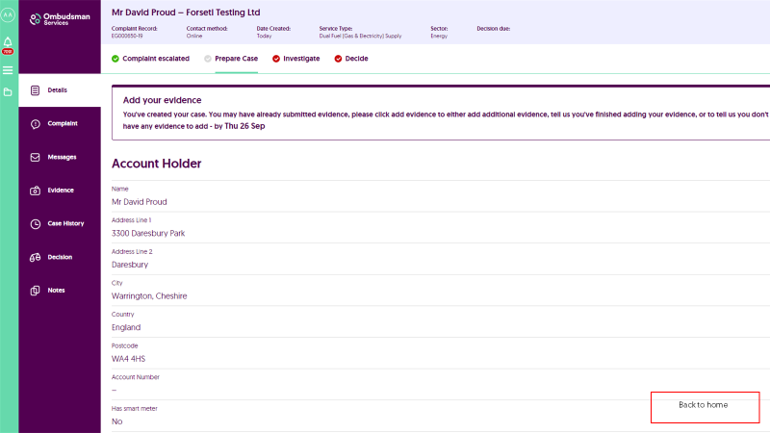
3. Case Management System

Slide 5
Benefits
3. Case Manageent System
3. Case Management System
Secure environment
Self serve
Real time update
Transparent
Central tracking tool
Available 24 hours a day
Dashboard available
Tried and tested methodology

Slide 6
4. Case File
It’s really important that you provide as much detail as possible, creating a case file addressing each point raised by the complainant with support from relevant evidence. This will help the Dispute Resolution Executive (DRE) understand what’s happened, your point of view and allow them to reach a fair and balanced decision.
Be sure to include all relevant evidence at the start of the complaint journey.
Importance of details
Allows us to be confident in our understanding of the full circumstances so we can make fair and well-informed conclusions.
They are shared with the microbusiness.
Tailored to the subject matter of the specific dispute.
Failure to provide relevant information at the beginning of the journey, means it may not be taken into consideration.
All evidence and information provided will be considered, weighed and will have a role to play in our decision process.
It reduces the need to double check or clarify specific details, saving valuable time for your business and ours.

Slide 7
4. Case File
Information to include
A summary of events that is understandable, avoids technical jargon and gives the broker’s view on the issues raised.
Any customer service records.
Letter of authority confirming you are acting on behalf of the microbusiness.
Any correspondence issued by the broker and/or any third party during the course of the dispute.
Correspondence received from the microbusiness and/or any third party during the course of the dispute.
Any research that a broker might have conducted before making the proposal.
Copy of the sales call/contract/documentation/welcome pack, if possible (for mis-selling disputes).
Any tenancy agreements/land registry documents held (for disputes involving change of tenancy).
A copy of all call recordings or confirmation that a call recording is not available (for cases where a microbusiness disputes the information/advice given during a specific customer service call). It is best practise to record all calls.
NB: You have 10 working days to prepare the evidence file, make sure to provide all your information during that period
Remember the complainant will be able to view these files and will be able to see any comments provided as part of the casefile

Slide 8
5. Investigation Process
How do we reach a conclusion?
We look at the dispute raised, and the information submitted by both parties
We review the information against relevant and expected industry rules and practice
We make our conclusion
Our aim is to give fair and balanced consideration to both parties’ viewpoints in order to reach an appropriate conclusion.
We determine what needs to be done to put the complainant back to the position they were in before the issue occurred
For further information, please see our Reaching a Conclusion document

Slide 9
5. Investigation Process
Appeal
New information not previously available
You can share new supporting information and give a reason why it was not available to us before.
For example, a further bill has been produced that shows our conclusion may be incorrect.
Factual error
You can show that a significant error has been made in the facts, which make a material difference.
For example, we used the wrong bills to calculate the resolution.
You will need to provide a clear explanation of why the new supporting information should make a difference to the conclusion.
Both parties will see the appeal information. The Dispute Resolution Executive dealing with the appeal will review all the information supplied by you and the microbusiness, before issuing the Appeal Decision. This decision is final and requires acceptance by the complainant to become binding. There is no option to appeal this final decision.

Slide 10
6. Resolutions
Fixing the Problem
When we decide that a consumer has been treated unfairly, we’ll require the broker to take corrective action to fix whatever problems have been caused. This will take the form of fixing the problem and/or requiring a time and trouble award.
to cover the difference between the tariff could have achieved and what was charged due to mis-selling
to clear incorrectly applied fees
to cover expenses a microbusiness has incurred as a result of an error or omission from the broker (e.g. bank charges)
to simply provide an apology for shortfalls in service

Slide 11
6. Resolutions
Time and Trouble
As well as fixing any problems that have occurred, in some cases we might decide that the broker should recognise the disruption that they have caused.
This might include requiring the broker to make a financial payment
We will consider the impact on the microbusiness and award accordingly
Some will have been impacted in practical way
Others might have been impacted in an emotional way

Slide 12
6. Resolutions
Time and Trouble
Everyone is different
We’ll take account of any payments the broker has already made
Not every mistake will be recognised with a financial award

Slide 13
6. Resolutions
Time and Trouble
£30 - £100
When more inconvenience or frustration than they might expect to in their day-to-day dealings with a broker such as not repeatedly not returning calls or responding to correspondence.
£100 - £250
When a microbusiness has experienced longer term problems which have caused a significant amount of upset – for example, receiving large payment demands that were not actually owed or not receiving help to sort out a serious problem.
£250 - £500
This level of award should be made in situations where the microbusiness has been put in an extremely distressing situation – for example, where their personal data has been shared inappropriately or the broker’s actions have affected the long-term running of the microbusiness.

Slide 14
7. Case Studies
Case Study #1
The Dispute
The Broker Response
OS Review
OS Resolution
The microbusiness was told by a broker that their preferred supplier would be unable to support their AMR meter type and agreed a contract with a different supplier over a two-year term.
They later learned that the preferred supplier could in fact support their meter and could offer a contract at lower rates than had been agreed.
The broker initially didn’t respond.
The broker later confirmed the contract details clearly stated within the validation call.
No further action taken.
Pre-sales call was requested but, was unavailable
Available evidence – sales validation call and the microbusiness’ testimony
We noted the microbusiness quoted information in the pre-sales call about support of their AMR meter type but wasn’t referred to in the sales validation call.
The microbusiness complained immediately after they spoke to preferred supplier.
Mis-selling had occurred
Remedy
Credit to reflect the difference in rates charged and the preferred supplier rates for the two-year period based on average consumption. This amounted to £1,125.
Goodwill payment of £75 and an apology.

Slide 15
7. Case Studies
Case Study #2
The Dispute
The Broker Response
OS Review
OS Resolution
The microbusiness claimed they had been sold a contract which had a fixed monthly payment of £110 for two years and wanted this to be honoured.
They had received a direct debit increase notification after three months to £160 per month.
The broker reviewed and maintained the contract sold was valid and the monthly payment was to be variable. The complaint was escalated to OS via a deadlock letter.
We listened to the validation and found that:
Key terms were discussed.
The microbusiness agreed.
No specific mention of monthly payments.
We requested copy of initial call, two days previous and found that:
The direct debit was discussed.
The broker advised amount may vary depending on consumption.
Direct debit would start at £110.
Based on this evidence, it appeared the microbusiness had mis-understood.
As we could see that the sale had been conducted correctly, with appropriate information provided, we decided that no remedy or award was warranted.

Slide 16
7. Case Studies
Case Study #3
The Dispute
The Broker Response
OS Review
OS Resolution
The microbusiness was approached by the broker who said they could secure a better deal for them.
New contract agreed with the director’s PA.
Director contacted the broker as not happy with deal agreed as PA not authorised.
PA advised they felt under pressure and that they were advised that there was a 14-day cooling off period.
The broker claimed no wrongdoing.
The broker stated the call was valid and the PA was clear that they were able to agree the new contract.
The broker confirmed that it was unable to supply the content of the call that took place prior to the call recording as this was not available as it did not form part of the contract.
Our review focused on the sales verification call and the consumer’s testimony. Within the verification call we noted that the PA had confirmed that they were able to agree the contract and the key terms of the contract were confirmed and agreed to.
While there was no direct reference to a 14-day cooling off period we noted the PA asked ‘are we able to cancel this as we discussed’ to which the broker responded ‘yes absolutely, everything you need to know will be in the terms and conditions that are sent out to you within the next 3-5 days.’
Enough evidence to suggest that a cooling off period was discussed previously.
PA confirmed they could agree, it was based on misleading information.
Remedy
The microbusiness able to go elsewhere .
The broker to provide a credit for the time period difference between the two suppliers.
A goodwill payment of £75 and apology.

Slide 17
7. Case Studies
Case Study #4
The Dispute
The Broker Response
OS Review
OS Resolution
The consumer who had been with the same supplier on fixed tariff contracts for over 10 years approached by the broker, who told them they worked on behalf of the supplier.
The consumer agreed to new terms and received a letter confirming a 3-year market tracker which does not match the rates they previously agreed.
The consumer called the broker on the number he was originally contacted on and was advised that they do not keep their calls for longer than 7 days, but the new supplier would have it.
The new supplier, advised that they do not have the call on file.
Heavily reliant on the consumer’s testimony.
The initial rate was lower than his current rate, we noted that the consumer had agreed fixed tariffs at every opportunity.
Contract was challenged immediately once paperwork had been received.
Mis-selling had taken place.
It will be difficult to make an award because we won’t know whether the customer will sustain a loss, and if they do how big it will be.
What should the remedy be in this case?

Slide 18
Any questions?

Slide 19
Thanks for your time
Please visit
Energy Brokers | Ombudsman Services (ombudsman-services.org)
For more information
energybrokerinfo@ombudsman-services.org

